Slide 1
Impact of Simplified Alignment on LLM Reasoning Performance
Group - 15
Team Members: Agastya Seth, Atharva Gupta, Bhavya Kandhari, Sudamshu S Rao

Slide 2
INTRODUCTION
Simplified alignment techniques aim to enhance the reasoning performance of Large Language Models (LLMs) in long-form question answering. However, this simplification may come at the cost of reasoning depth and accuracy in complex tasks.
Our study aims to evaluate how simplified alignment affects the reasoning benchmarks like MMLU and GSM8K, examining the trade-offs between clarity and reasoning performance.
We hypothesize that simplification could result in changes to reasoning quality, offering both potential benefits and drawbacks.
Notes:
Feature matching ; sorting, post processing,

Slide 3
MOTIVATION
Large Language Models (LLMs) are increasingly used in diverse real-world applications, ranging from education to high-stakes fields like healthcare and law. Simplifying LLM outputs enhances accessibility for non-experts but raises concerns about potential losses in reasoning depth and accuracy.
This study addresses key questions such as:
How does alignment for simplicity affect logical reasoning?
Can models achieve improved accessibility without sacrificing reasoning depth?
Understanding these trade-offs is crucial for designing LLMs that balance usability and performance across varying tasks and audiences.
Notes:
Feature matching ; sorting, post processing,

Slide 4
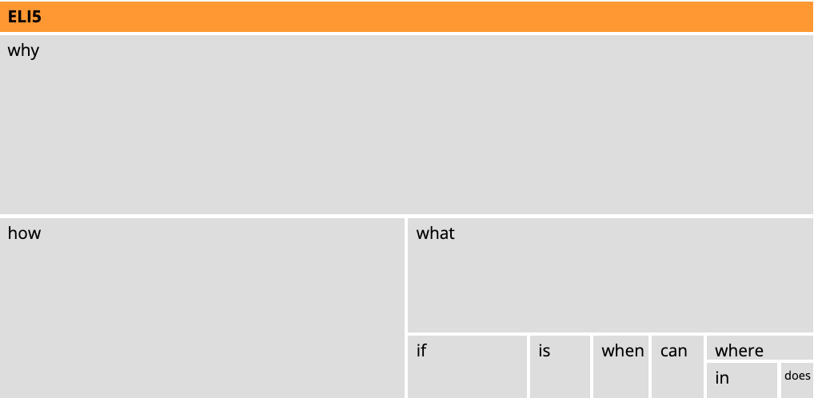
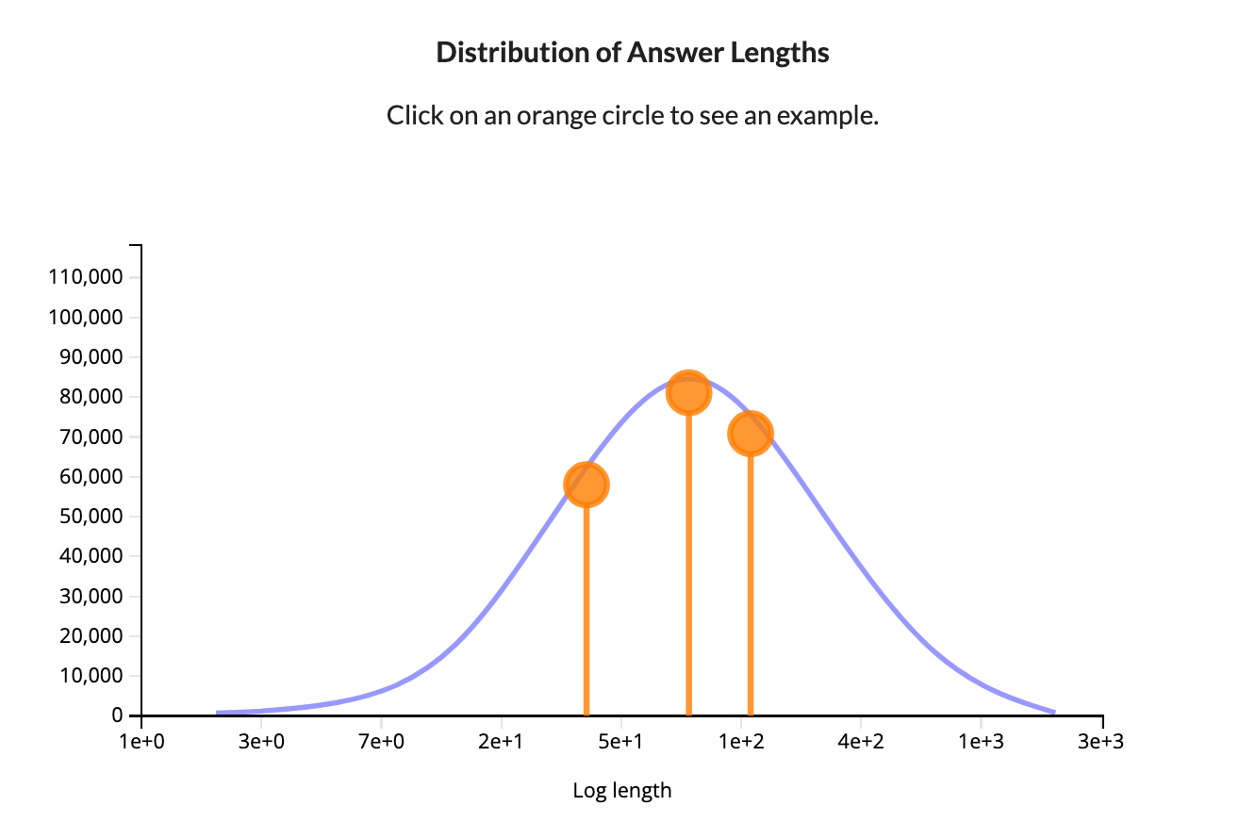
DATASETS
Alignment Dataset:
ELI5 Dataset:
Contains simplified explanations designed for clarity and accessibility.
Features long-form open-ended questions requiring comprehensive, multi-sentence answers.
Notes:
Feature matching ; sorting, post processing,

Slide 5
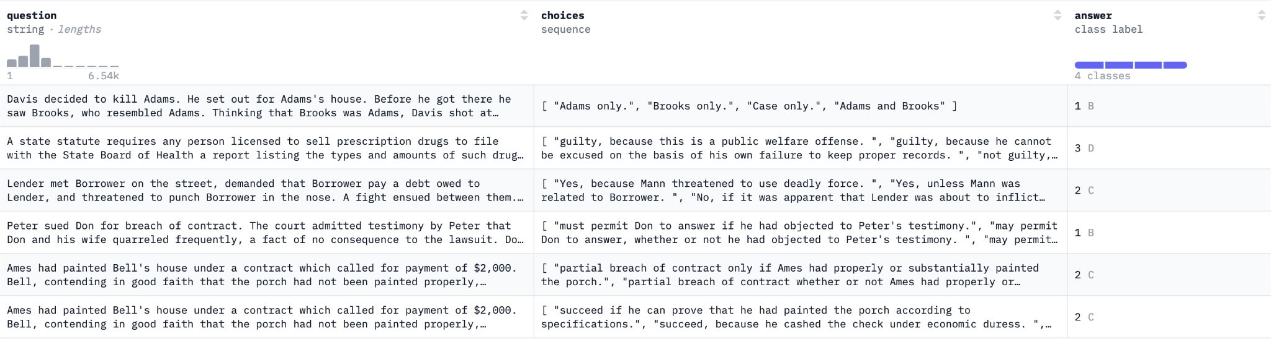
DATASETS
Evaluation Dataset:
MMLU (Massive Multitask Language Understanding)
This dataset tests broad knowledge and reasoning across 57 subjects.
Notes:
Feature matching ; sorting, post processing,

Slide 6
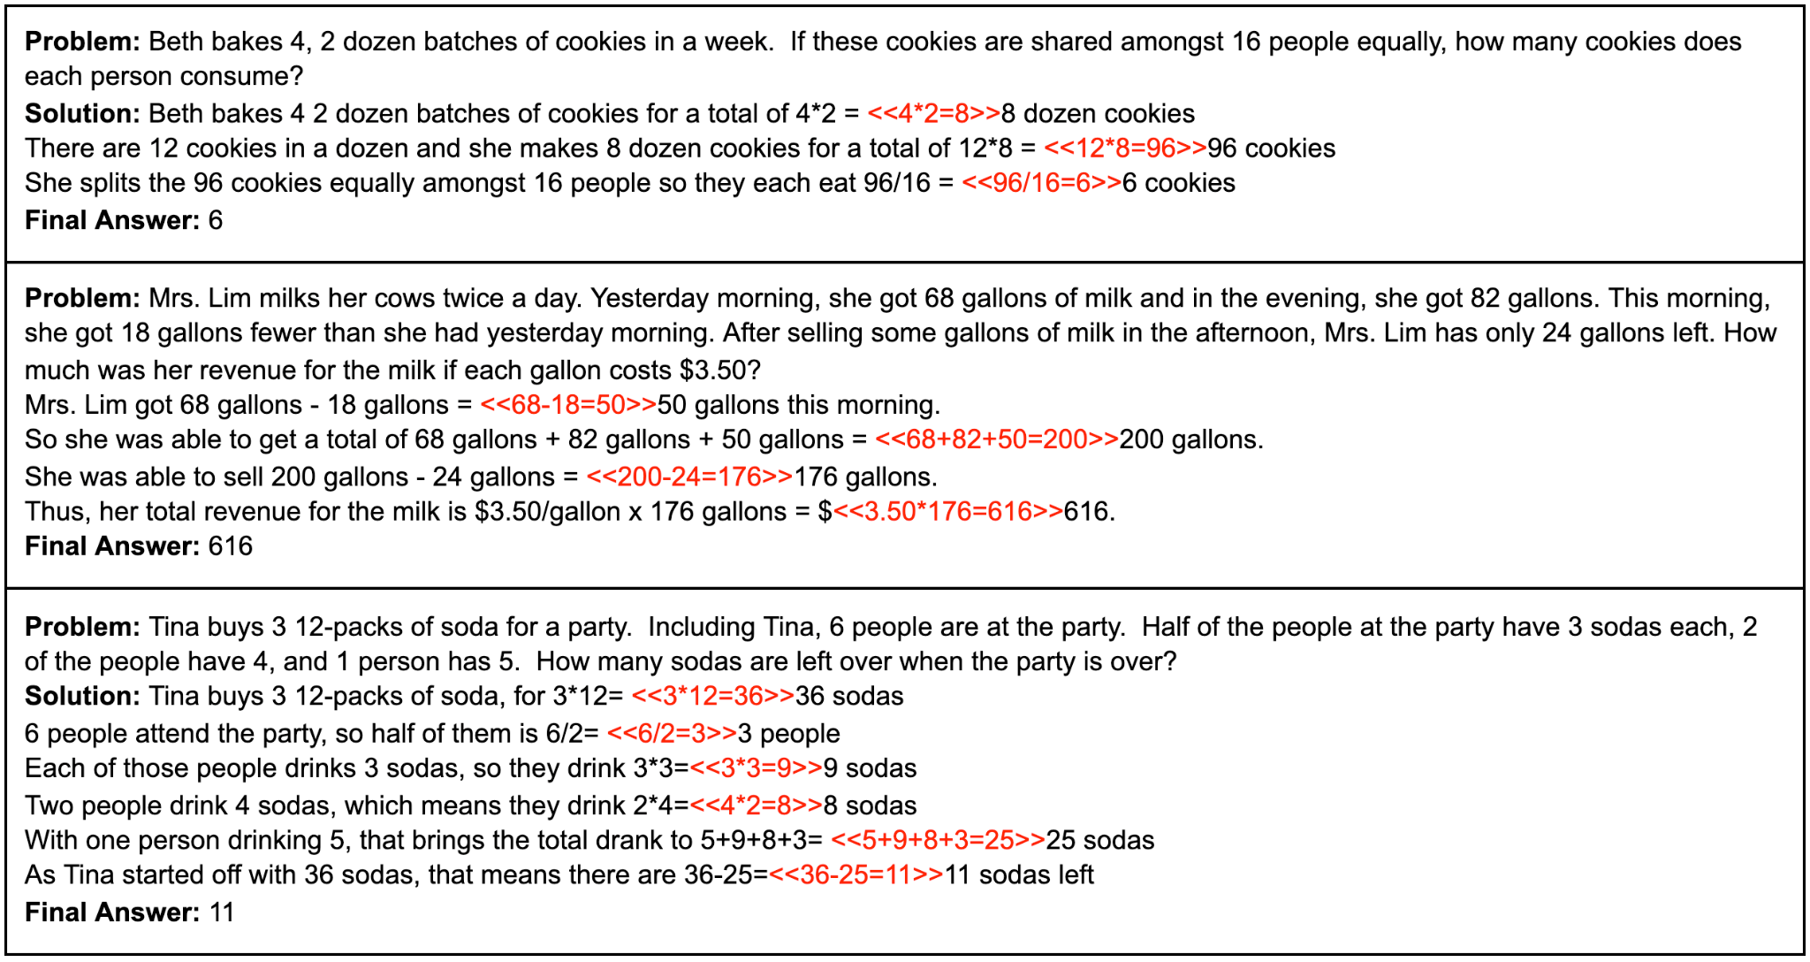
DATASETS
GSM8K (Grade School Math 8K)
Focuses on multi-step logical reasoning through mathematical word problems.
Notes:
Feature matching ; sorting, post processing,

Slide 7
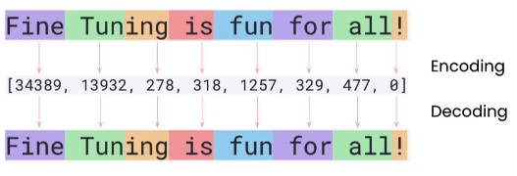
METHODOLOGY
Data Preprocessing
Researched and Standardized Datasets.
For Question and Answer Processing, we used tokenization, text normalization and noise removal. For supporting document processing, we used sentence splitting and selection, heuristic passage extraction, concatenation and restructuring.
Notes:
Feature matching ; sorting, post processing,

Slide 8
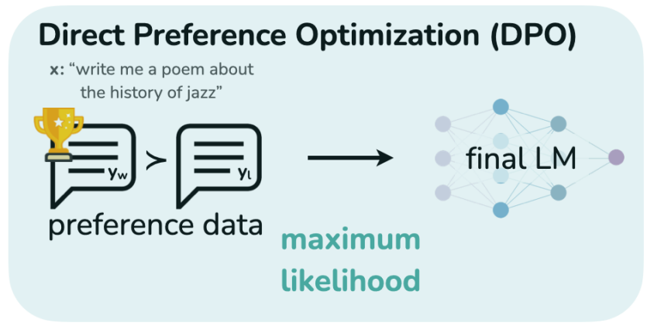
METHOD CHOICE AND IMPLEMENTATION
Alignment Framework:
We utilized Direct Preference Optimization (DPO) to fine-tune LLMs.
Trained models to prioritize clarity and simplicity in responses, aligning with ELI5-style outputs.
Notes:
Feature matching ; sorting, post processing,

Slide 9
EXPERIMENT DESIGN
Our study uses two baseline instruction-tuned models to evaluate effect of model size:
Llama 3.1 Instruct 8B
Llama 3.1 Instruct 70B
For Fine-Tuning our models, we applied Direct Preference Optimization (DPO) to align outputs with ELI5-style clarity. The models are iteratively adjusted to balance accessibility and reasoning depth.
Notes:
Feature matching ; sorting, post processing,

Slide 10
EXPERIMENT DESIGN - DPO TRAINING CONFIGURATION
Models: Llama 3.1 (8B Instruct), Llama 3.1 (70B Instruct)
Dataset: ELI5 for alignment; GSM8K and MMLU for evaluation.
Batch Size: 16
Epochs: 3
Learning Rate: 2e-5 with cosine annealing
Optimizer: AdamW
Precision: Mixed Precision (FP16)
GPUs: 4 NVIDIA A100 GPUs (80GB each)
Notes:
Feature matching ; sorting, post processing,

Slide 11
EVALUATION METRICS
Quantitative Metric: Accuracy Measure the percentage of correct answers generated by the model compared to the ground truth.
Purpose: Provides a clear metric to compare model performance before and after alignment with examples.
Qualitative Metric: ROSCOE A metric designed to evaluate the quality of reasoning in generated responses.
Key Components:
Logical Coherence: Measures if the steps in the reasoning process are logically connected.
Relevance: Assesses whether each step contributes meaningfully to the final answer.
Completeness: Evaluates whether all necessary reasoning steps are included in the response.
Purpose: Used to qualitatively analyze how well the model explains its answers, particularly on reasoning-intensive tasks like GSM8K.
Notes:
Feature matching ; sorting, post processing,

Slide 12
RESULTS AND OBSERVATIONS
Evaluation Overview:
Conducted on reasoning benchmarks such as MMLU and GSM8K using few-shot prompts.
Performance measured across multiple subjects and categories to assess reasoning accuracy and clarity.
Preliminary Insights:
Initial observations suggest potential trade-offs between alignment for simplicity and reasoning depth.
Examples-based prompts improved contextual understanding and response accuracy for some tasks.
Challenges Faced:
Variations in performance across different subject areas.
Difficulty in generating coherent multi-step reasoning for complex benchmarks.
Notes:
Feature matching ; sorting, post processing,

Slide 13
QUANTITATIVE RESULTS: MMLU ACCURACY BY SUBJECT
Subject Category | Baseline (Pre-Alignment) | Post-Alignment with Examples | Change
Humanities | 42.1% | 50.4% | +8.3%
STEM | 39.8% | 35.4% | -4.4%
Social Sciences | 41.2% | 38.7% | -2.5%
Other Professions | 36.7% | 34.3% | -2.4%
Post-alignment improved performance in Humanities (e.g., history, literature), likely due to better contextual understanding with examples.
Significant drops were observed in STEM and Other Professions, possibly due to oversimplification of responses.
Overall, the alignment did not yield consistent improvements across categories.
Notes:
Feature matching ; sorting, post processing,

Slide 14
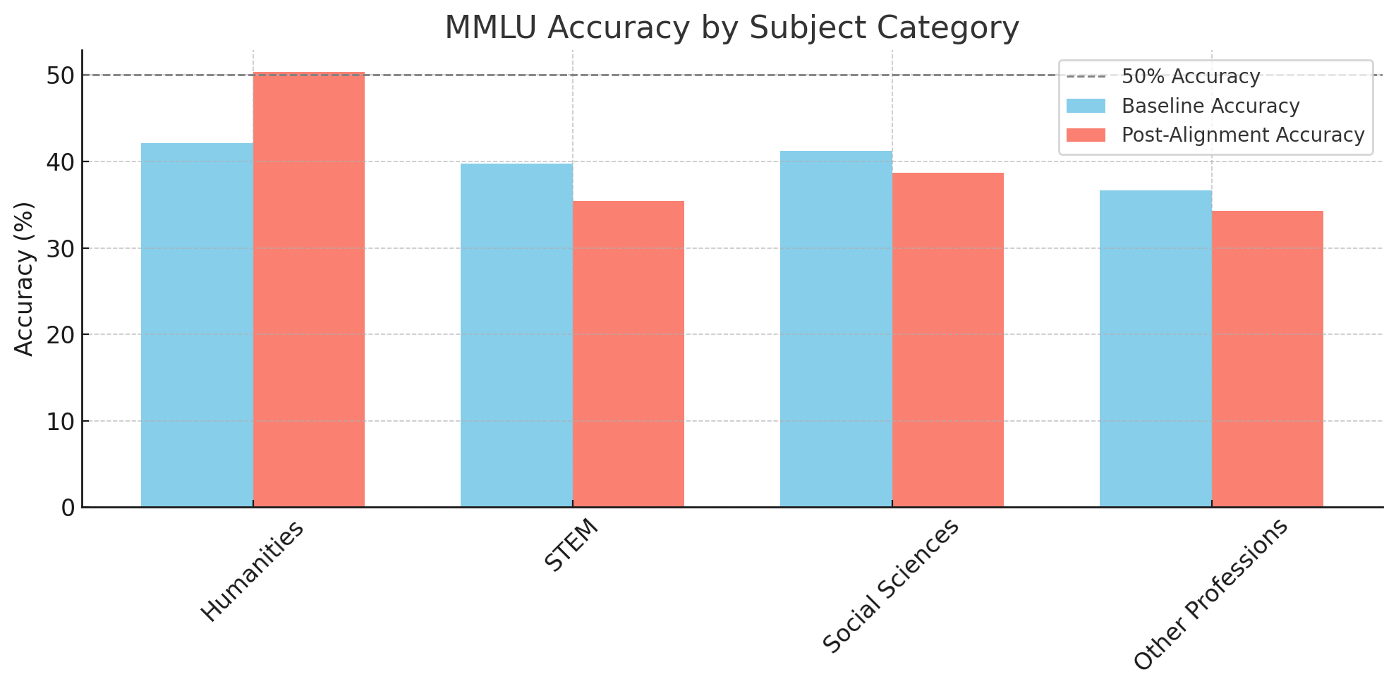
QUANTITATIVE RESULTS: MMLU ACCURACY BY SUBJECT
Notes:
Feature matching ; sorting, post processing,

Slide 15
QUALITATIVE RESULTS: MMLU: REASONING QUALITY (ROSCOE SCORES)
Metric | Baseline (Pre-Alignment) | Post-Alignment with Examples | Change
Logical Coherence | 65.2% | 67.8% | +2.6%
Relevance | 60.5% | 55.7% | -4.8%
Completeness | 58.7% | 54.1% | -4.6%
Logical Coherence improved slightly, indicating better flow between reasoning steps.
Relevance and Completeness dropped significantly, suggesting a loss of focus and missed intermediate steps in complex reasoning tasks.
Notes:
Feature matching ; sorting, post processing,

Slide 16
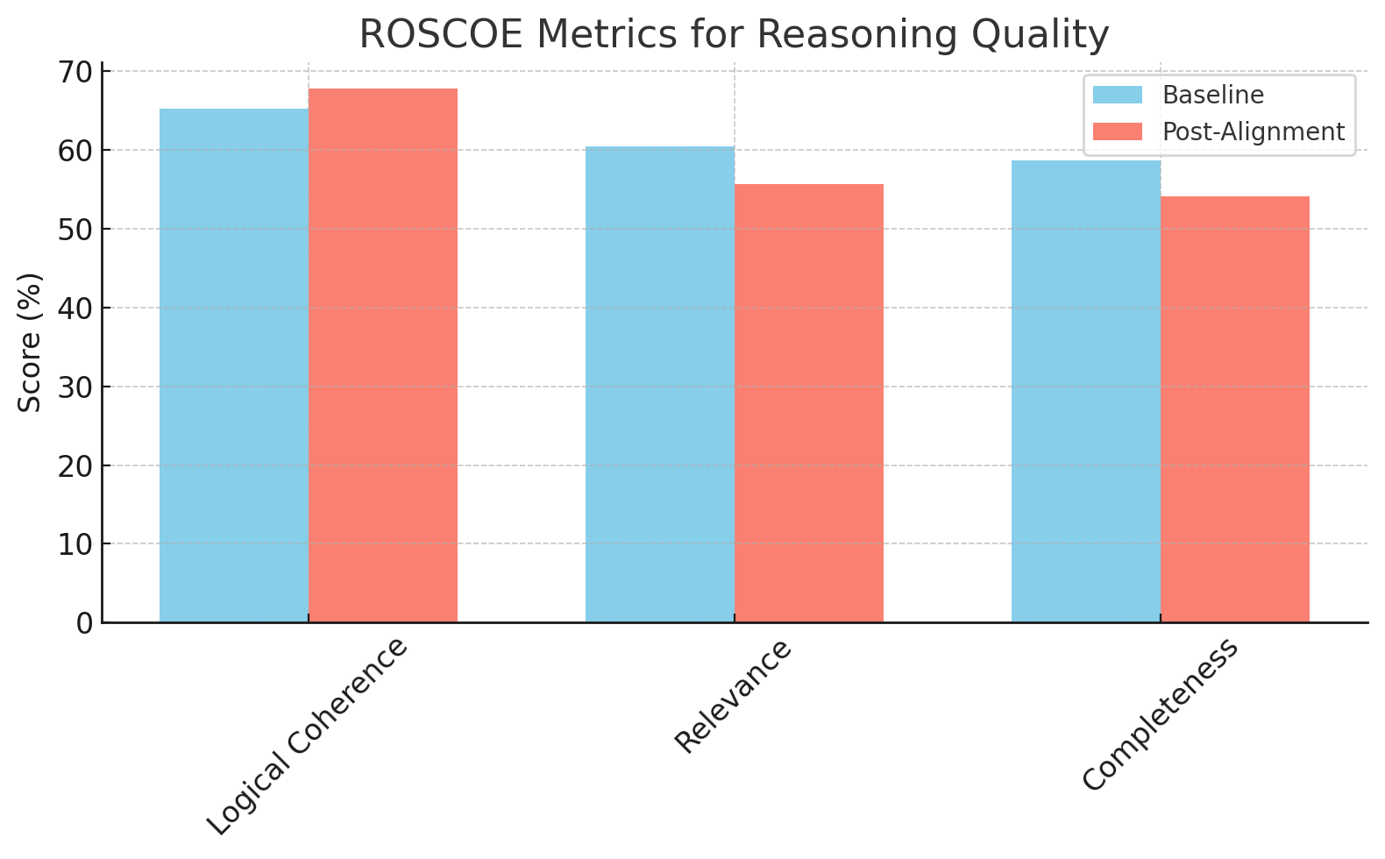
QUALITATIVE RESULTS: MMLU: REASONING QUALITY (ROSCOE SCORES)
Notes:
Feature matching ; sorting, post processing,

Slide 17
QUANTITATIVE RESULTS: GSM8K ACCURACY BY TYPE
Metric | Baseline (Pre-Alignment) | Post-Alignment with Examples | Change
Single-Step Questions | 55.2% | 58.7% | +3.5%
Multi-Step Questions | 43.8% | 38.5% | -5.3%
Overall Accuracy | 49.5% | 46.3% | -3.2%
Single-Step Questions: Minor improvement (+3.5%) post-alignment suggests examples helped in simpler tasks.
Multi-Step Questions: Accuracy declined significantly (-5.3%), likely due to oversimplified responses and missing reasoning steps.
Overall Accuracy: A slight overall drop (-3.2%) indicates alignment trade-offs, especially for complex reasoning.
Notes:
Feature matching ; sorting, post processing,

Slide 18
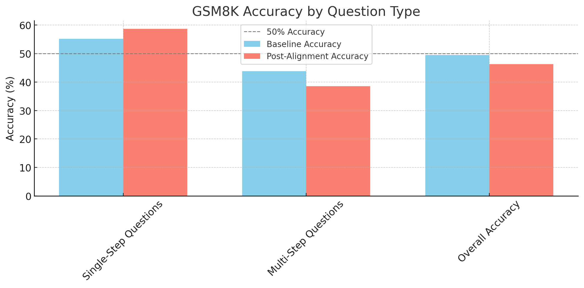
QUANTITATIVE RESULTS: GSM8K ACCURACY BY TYPE
Notes:
Feature matching ; sorting, post processing,

Slide 19
QUALITATIVE RESULTS: GSM8K: REASONING QUALITY (ROSCOE SCORES)
Metric | Baseline (Pre-Alignment) | Post-Alignment with Examples | Change
Logical Coherence | 64.5% | 66.2% | +1.7%
Relevance | 59.4% | 57.1% | -2.3%
Completeness | 55.8% | 51.2% | -4.6%
Logical Coherence: Improved slightly, suggesting better flow in reasoning steps.
Relevance and Completeness: Both dropped, with responses omitting critical intermediate steps or including irrelevant details.
Notes:
Feature matching ; sorting, post processing,

Slide 20
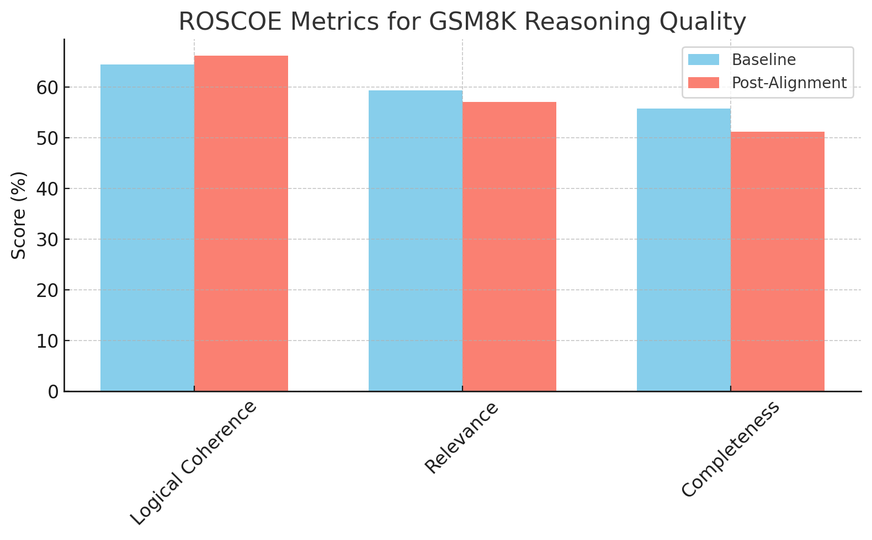
QUALITATIVE RESULTS: GSM8K: REASONING QUALITY (ROSCOE SCORES)
Notes:
Feature matching ; sorting, post processing,

Slide 21
REAL-WORLD APPLICATION
Designing Adaptive LLMs
Develop models that can switch between clarity-focused and reasoning-intensive modes based on task-requirements.
Applications in Education and Accessibility
Simplified alignment can be used to make complex concepts more accessible in educational tools and customer support systems
Informing Alignment Strategies
Guide the development of future alignment techniques that balance usability with reasoning performance.
Notes:
Feature matching ; sorting, post processing,

Slide 22
CONCLUSION AND FUTURE WORK
This study evaluates the impact of simplified alignment on the reasoning capabilities of LLMs. By exploring the trade-offs between clarity and reasoning depth using benchmarks like MMLU and GSM8K, it highlights the challenges and opportunities in designing aligned models.
Future Work
Extend alignment evaluation to other styles, such as ethical or factual alignment.
Explore adaptive alignment strategies that dynamically adjust to task-specific requirements.
Focus on evaluating reasoning chain better
Investigate scalability and computational efficiency in alignment techniques
Notes:
Feature matching ; sorting, post processing,

Slide 23
THANK YOU

